Slide 1

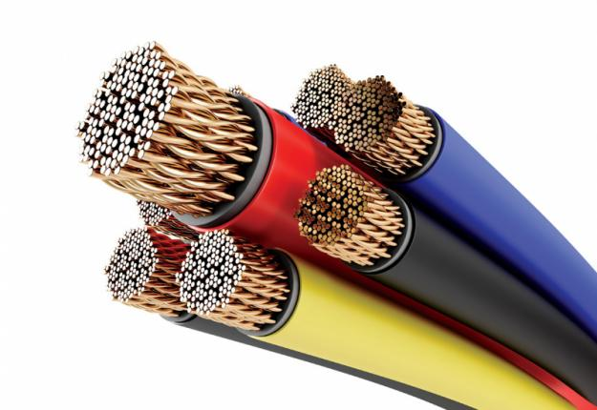
S. S. I. CABLES
UNMATCHED QUALITY, UNBELIEVABLE SERVICES

Slide 2

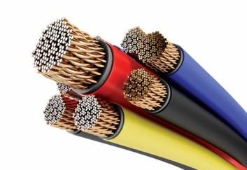
Brief Summary
A decade old organisation thriving on research, innovations, and strong value system. S.S.I CABLES, the manufacturer and exporter of customised PTFE (Teflon) Wires and Cables is continuously heading on the success path to deliver excellent and comprehensive cable solutions to its customers, both in India and across the border.
The unparallel success of S.S.I. CABLES lies in receptive approach, managerial capabilities and vision to forecast changes in market and technology. S. S. I. CABLES understands and anticipates the needs and wants of customers to cater the market with quality PTFE (TEFLON) cables and wires.

Slide 3

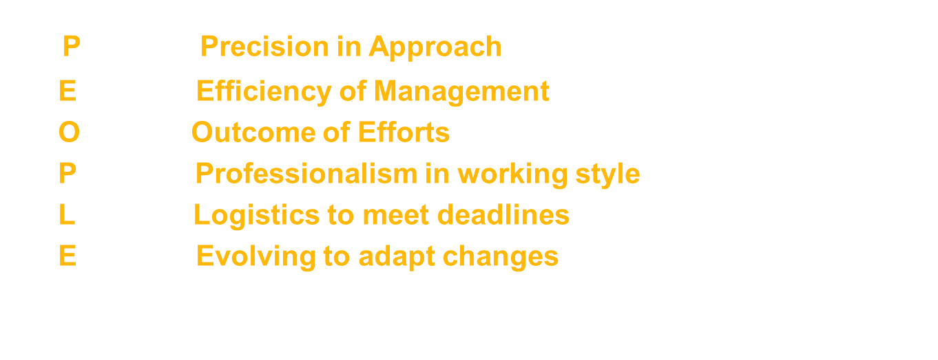
Our Strength Livewire Support

Slide 4
Our Value System Transparent & Shockproof
Believe in consistent and mutual growth of the organisation and clients.
Customised Solutions as per the clients' needs.
Strict adherence to quality policies.
Competitive prices for valuable products .
Highly customer centric approach.
Environmental friendly production process.
Transparent and clear business objectives.

Slide 5
Why S. S. I. CABLES ? Our Potential Your Power
Proven track record of supplying best quality, best services and on time delivery.
Consistent performance
Reasonable prices
100% Tested Quality which is safe and efficient to use.
Timely delivery to meet the deadlines
Customized Solutions Available
Wide Range of Products
Experience of accomplishing the big projects.
Advance Machines and Technology available to meet the customers' demand.

Slide 6
Achievements Drive To Deliver Excellence
Reached to more than 20 export destinations in just 12 years.
200 percent of growth rate in the year 2011.
A production capacity of 50,000 metre wires and cables per day.
A partner in the growth of institutions like DRDO, BHEL, ECIL, NPCIL, ISRO, HAL and NTPC, DAE.
Our cables haven been used in T-90 Tanks, Prithvi Missiles, Brahmos Missiles, upcoming Helina Missiles, Pinaka Rocket Systems and other defence projects.
Design and developed cables for special uses as (-200 Deg. Cent.) Reactor Cable, 100KV AC HV Cable, 75 Core Marine Cable, Seeker Cables and many more

Slide 7
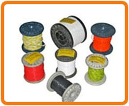
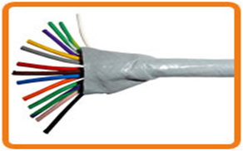
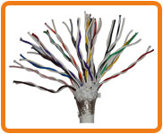
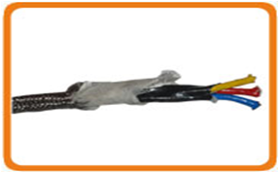
Product Portfolio For a reliable performance
S. S. I. CABLES'S incredible range of PTFE wires and cables encompasses.
PTFE (Teflon) Insulated Single Core Wires
PTFE (Teflon) Insulated Multi Core Cables
PTFE (Teflon) Insulated Single Core, Multi Core and Multi Pair Shielded and Armored Cables
PTFE (Teflon) Insulated HR Cables (Heat Resistance Cables) up to 900 Deg. Cent.

Slide 8
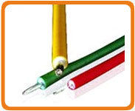
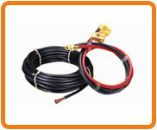
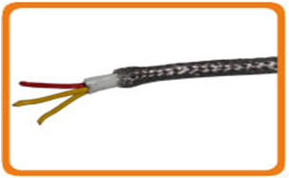
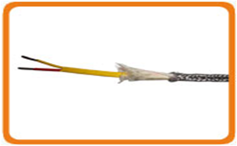
PRODUCTS
CR (Corona Resistance) PTFE and Kapton Insulated HV Cables (High Voltage Cables) up to 50 KV DC
PTFE Insulated Low Voltage and High Current DC Cables up to 500 Amperes
PTFE Insulated RTD Cables.
(2 cores, 3 Cores, 4 Cores and 6 Cores, Etc.)
PTFE Insulated Compensating and Thermocouple Cables. ('K' Type, 'T' Type, 'J' Type, 'R' Type and 'S' Type Etc)

Slide 9
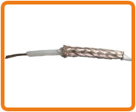
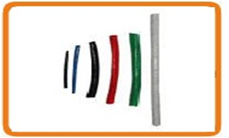
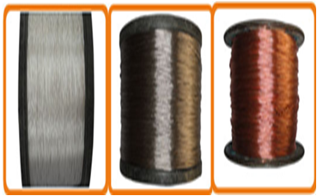
PRODUCTS
PTFE Insulated RF Co - Axial Cables.
(RG 196 A/U, RG 188 A/U, RG 187 A/U, RG 195 A/U, RG 178 A/U, RG 179 A/U and RG 316 A/U Etc.)
PTFE Sleeves. (0.50 mm ID (Inner Dia) up to 25.00 mm ID)
Conductors. Silver Plated, Nickel Plated and Annealed Bare Copper Stranded Conductors in various sizes 0.05 Sq.mm up to 70.00 Sq.mm.

Slide 10
Quality Assurance and R&D Precision is our quality benchmark
Complying the international quality standards like LCSO 51034, LCSO 51038, ISO and others in an stringent manner.
Adaptation of high-end technology deliver premium quality products.
Quality raw material from the finest sources.
Usage of grade-1 copper, PTFE resin and silver.
Constant quality check at each stage of the product development.

Slide 11
Features of PTFE ( Teflon) Wires and Cables
1. Excellent Resistance Power to Heat, Sunlight, Acids, Gasoline, Oil, Fungus and Mold Growth
2. High Surface Resistance and Fair Corona Resistance
3. Suitable for very wide frequency range (DC to above 10000 MHz)
4. Aging Less
5. Low Dissipation Factor (< 0.0003)
6. Available in 12 different Single colours and many Bio and Trio Colours
7. Can be customized as per customer requirements
8. High operating temperature from (- 65 Deg. Cent.) up to (+ 270 Deg. Cent.)
9. Excellent Flex life and totally unaffected by out doors exposure to unlimited period
10. Moisture and Flame Proof

Slide 12
Industries Availing Our Services
Ignite To Energize
Railways, Defence, Aeronautics, Telecommunications, Space Centres, Steel Plants, Power Plants, Chemical Plants, Atomic Energy Plants, Automobiles Industry
and many others.

Slide 13

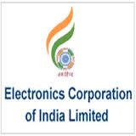









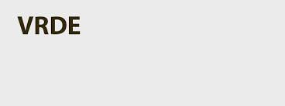
Our Patrons In India
& many more….

Slide 14

S. S. I. CABLES'S Presence In The Global Sphere ( Exports )
USA, UK, Singapore, Australia, South Africa, Italy, Malaysia, Argentina, Ireland, Devon, Algeria, Bangladesh, Gulf countries like Iran, Iraq, Saudi Arab, and many others.

Slide 15
Growth Evidences Heading Towards Momentous Growth

Slide 16
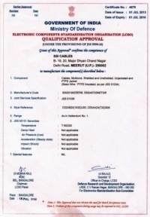
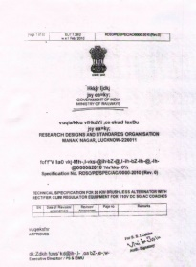
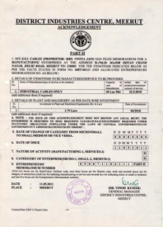
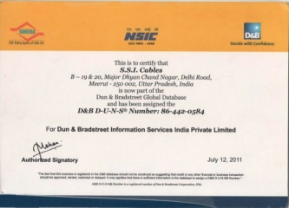
Our Credentials
Qualification Approval Certificate
Ministry of Defence, Govt. of India
Certificate
Ministry of Railways
Govt. of India
District Industries Centre
Meerut, Govt. of UP
NSIC Certificate

Slide 17
CONTACT US:
SSI Cables Mr. Amit Jain (CEO) B - 19,20,21, Major Dhyan Chand Nagar, Delhi Road, Meerut, UP - 250002, INDIA Telefax + 91 - 121 - 2401051 Cell + 91 - 9359901144, 8979000811 Email ssimpexes@yahoo.com, ssicables@gmail.com Websites: www.ssicables.com, www.ptfewirecables.com

Slide 18

Thanks

